Slide 1


MOVIE RECOMMENDATION SYSTEM
Notes:
greetings

Slide 2
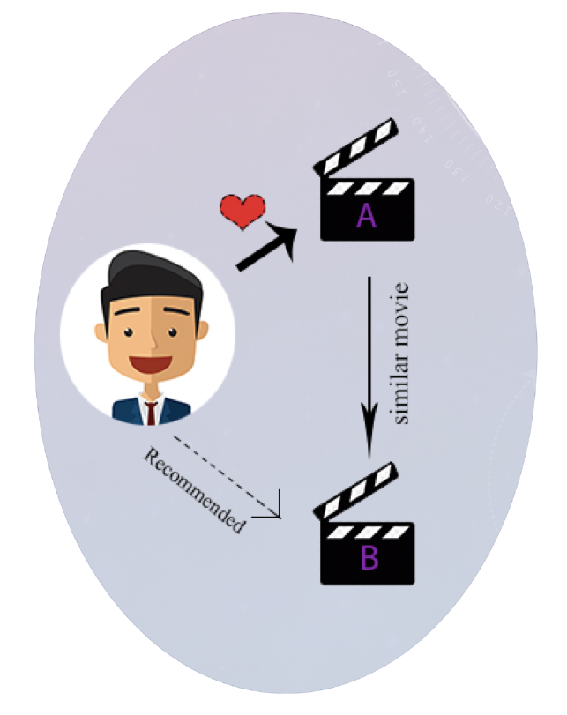
02
INTRODUCTION
Platforms like Netflix are able to recommend us TV shows or movies by using Recommendation systems.
Recommendation systems are of 3 types :
Content based filtering, Collaborative filtering, Hybrid filtering.
Content-based filtering first checks the user preference and then suggests the movies or any other product to him. It only focuses on a single user’s ideas, thoughts and gives predictions based on his interest.
Notes:
You might have wondered sometime or at some point that how do platforms like Netflix are able to recommend us TV shows or movies, they use Recommendation systems.

Slide 3

03
PROJECT FLOW
Deploying
website
Building the recommendation model
Producing similarity matrix
Preprocessing
and preparing
tags
Data
Selection

Slide 4
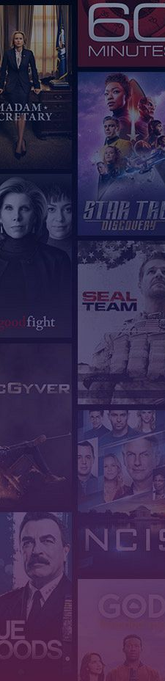
04
DATA
Source: TMDB 5000 Movie Dataset: Kaggle
The dataset contains two CSV files named movies and credits with 4803 rows.
In total there are 23 features, which include title, crew, cast, revenue, genre, overview, popularity etc.,
There are 10 numerical features and 13 categorical features.
The features that are useful to recommend movies are :
movie_id, genres, title, overview, cast, crew, keywords
Trim the data frame to the Required features (i.e helpful in recommending) :
{ movie_id, genres, title, overview, cast, crew, keywords
Notes:
NA values removal
cast- first 3 actors names(removed spaces)
crew- director

Slide 5
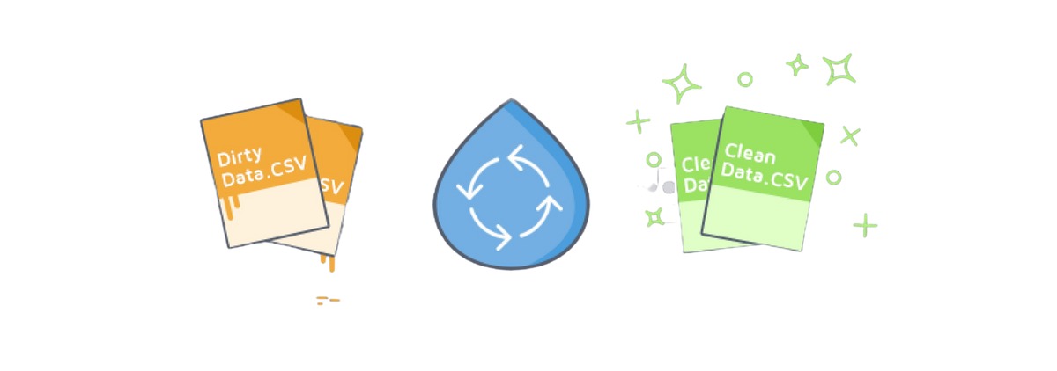

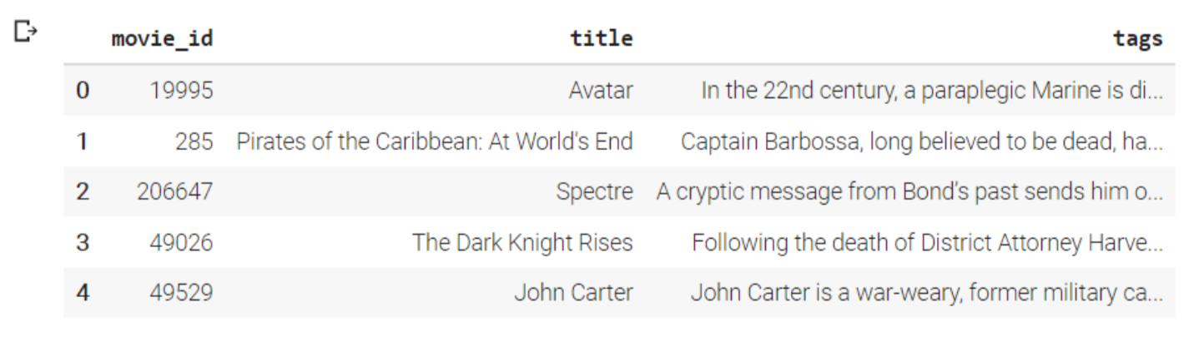

05
Preprocessing and Preparation of tags
Prepare "Tags" (a string datatype) for all the rows by concatenating all the Required features.
Run the "Tags" through the CountVectorizer function to get the count vector.
As the name suggests, CountVectorizer counts the frequency of each word and outputs a 2D vector containing frequencies.
PROCESSING

Slide 6
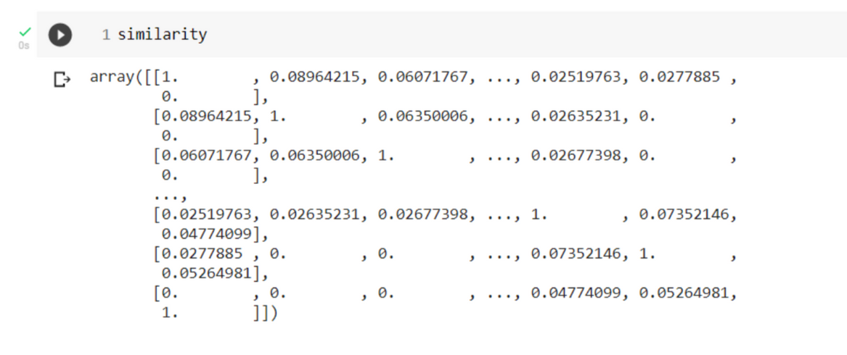
06
Producing Similarity Matrix
There exist several similarity score functions such as cosine similarity, Euclidean distance, etc. Here, we use the cosine similarity score as this is just the dot product of the vector output by the CountVectorizer.
Create a Similarity matrix by applying the cosine similarity function to the output of the CountVectorizer function.
Similarity Matrix contains similarity scores of all the movies with respect to the movie indexed to the particular row.
Notes:
why cosine similarity?
vs Euclidean distance

Slide 7
07
Building the recommendation model
recommend() method gets the list of similarity scores for all the movies for a given movie
Sorts the list in descending order and matches them with a corresponding movie title
Finally, our model recommends movies with top 10 similarity scores for a given movie.
Deploying the model
The recommendation model is successfully built and it can be used in many applications
A website or application which needs a recommendation system can make use of our model
link to the website

Slide 8
Thank you

